Slide 1
SEC555
Presentation based on SEC555: SIEM with Tactical Analytics
Stuck in the Box: A SIEM’s Tale
Justin Henderson (GSE # 108)
@SecurityMapper

Slide 2
About Me
Author of SEC555: SIEM with Tactical Analytics
GIAC GSE # 108, Cyber Guardian Blue and Red
58 industry certifications (need to get a new hobby)
Two time NetWars Core tournament winner (offense)
And security hobbyist and community supporter
Collecting interns/contributors in bulk (research teams)
Release research to the community
See https://github.com/SMAPPER

Slide 3
Welcome!
A copy of this talk is available at: https://github.com/SMAPPER/presentations
More free stuff: https://github.com/HASecuritySolutions Disclaimer: This talk is NOT about bashing SIEM solutions or promoting one vendor/solution over others

Slide 4

SIEM Detection Gap
Working with multiple organizations there are clearly gaps in SIEM deployments
Example: One organization spent 14 months in deployment
SIEM was/is within top 5 of magic quadrant 2014 - 2017
Two employees during roll out (> 1 FTE of labor for 14 months)
Within less than 1 month open source solution exceeded what they had - By a lot…

Slide 5

Case Study
Well they must have lacked training and planning, right?
Both employees attended week long vendor training
POC lasted well over three months
Implementation had >30 days of professional services
One employee hired as dedicated FTE to SIEM
One PTE and other employee(s) available to help
Above looks better than what some organizations get

Slide 6
What Happened?
Ultimately the company discarded commercial solution
Open source solution still in place
People and processes are more important than the tool!
Focus should not be solely on SIEM care and feeding
Detection techniques are required and must scale
Automation is a must!
Next slides shows some steps organization took
How does your current solution hold up?

Slide 7
NXLog AutoConfig
Overcomes log agent deficiencies and is a functional proof of concept
https://github.com/SMAPPER/NXLog-AutoConfig
Checks systems each day looking for components (IIS, etc)
If found, automatically configures for consistency
Or initial configuration…
Then sets up agent to start shipping logs
Use case organization spent lots of time managing agents

Slide 8

Traditional vs Network Extraction
Traditional
Network Extraction
Multiple collection points
Single collection point
DNS logs
SMTP logs
HTTP logs
DNS logs
SMTP logs
HTTP logs
Log Aggregator
Log Aggregator
agent
agent or syslog
agent or syslog
agent
DNS Server
SMTP Server
Web Proxy
Network
Extraction Sensor

Slide 9

Log Enrichment and Adding Context
Infrastructure Service Logs
Enrichment Techniques
DNS
HTTP
HTTPS
SMTP
Almost every network uses them
Lots of noise = lots of logs
Yet can be high value
Low value logs can morph into highly actionable detects
Baby Domains
Entropy Test (PH Imbalance)
Invalid Fields (wrong state)
Fuzzy Phishing

Slide 10
Ordinary to Extraordinary
query: www.google.com
query: www.google.com
subdomain: www
parent_domain: google
registered_domain: google.com
creation_date: 1997-09-15
tags: top-1m
geo.asn: Google Inc.
frequency_score: 18.2778256342
parent_domain_length: 6
Enriches to this

Slide 11

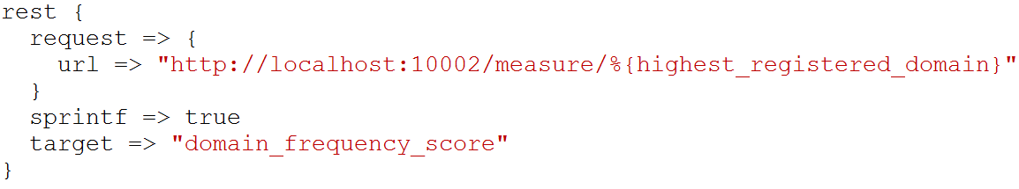
freq_server.py
freq_server.py is for large scale entropy tests
Created by Mark Baggett, author of SEC573
Manual testing
Logstash query

Slide 12
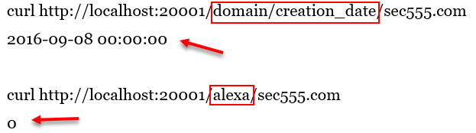
domain_stats.py
Mark Baggett developed domain_stats.py
Designed for speed and log analysis
Provides on mass domain analysis
Provides whois information like creation date
And top 1 million lookups (works with Alexa and Cisco)
Result
Result

Slide 13
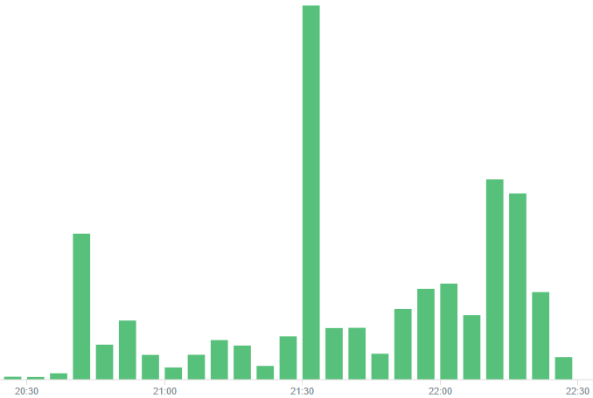
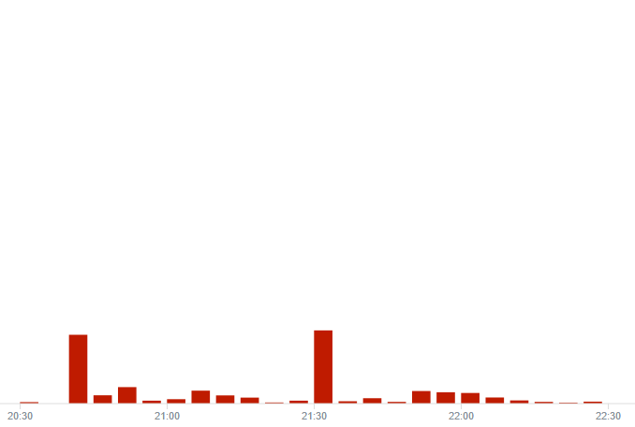
Top1M Filtering
Before
After - approx < 90% logs

Slide 14

Fuzzy Phishing
Many SIEM techniques use insider information
Such as fuzzy phishing searches
Take legitimate company domains and look for variants
Extremely effective against phishing domains
Best used in combination with email alerts or scripts
Great for targeted attacks

Slide 15
Endpoint Analytics
Endpoint logs are incredibly powerful yet underutilized
Too much emphasis on “insert security product here”
Not enough visibility on desktops/laptops
Endpoint logs can readily be operationalized
Strategies such as below can be used to detect attacks using
Long command lines
Unauthorized service creations
Malicious PowerShell use
Internal Pivoting
Brute force logins
Whitelist evasion

Slide 16
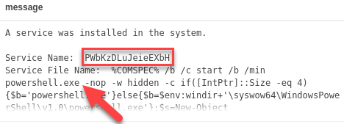
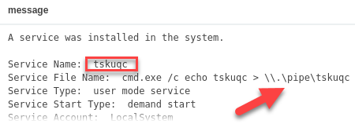
Service Creation Gone Bad (Event ID: 7045)
Common attack techniques create services
Top example is of Meterpreter compromise through PSExec
Bottom event is of privilege escalation

Slide 17
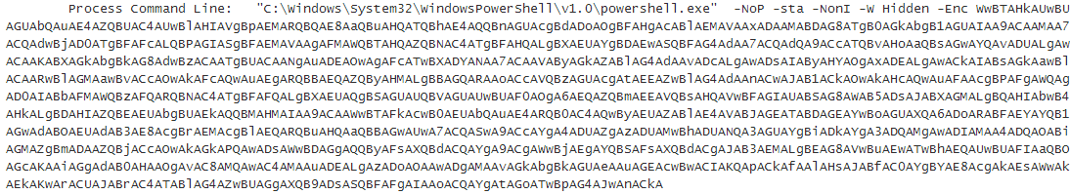
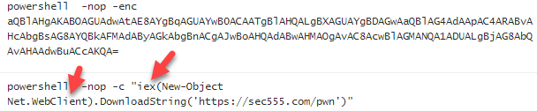
PowerShell Attacks (Event ID: 4104 or 4688)
PowerShell is now commonly used for modern attacks

Slide 18
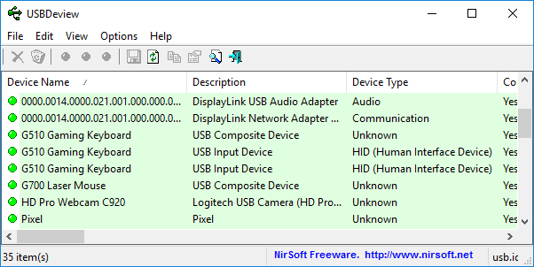
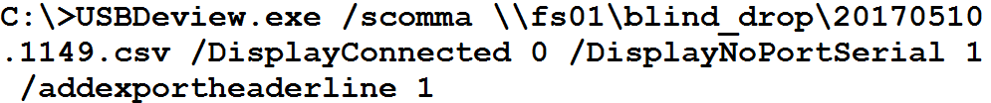
NirSoft USBDeview¹
Simplification is acceptable/preferred
Possible to run 3rd party tool once a day and log to file
Better late than never

Slide 19
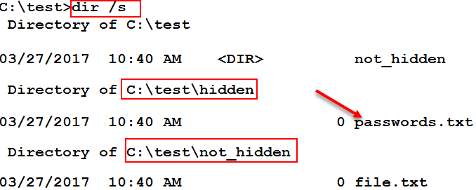
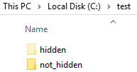
File Auditing (Event ID 4663)
Automated scripts/malware often used to find patterns
Social security #, credit card #, or drivers license
Operate by enumerating and reading through files
Often ignores hidden folders

Slide 20
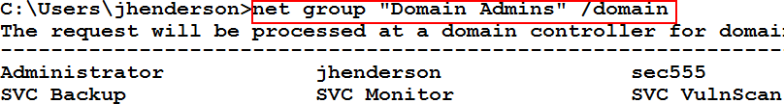
Group Querying (Event ID 4662 and 4663)
By default all users can list group members
Attackers enumerate members to find users to target
Many alternative methods to list group members
Mickey Perre has a blog on detecting this behavior
Windows auditing can capture read member requests
Combined with agent/aggregator filters = AWESOME

Slide 21
HALO (Honeytokens Against Leveraging OSINT)
Fake users can be created publicly to combat recon
Could be just in hidden metadata and/or key public sites
Example: Peter Parker(pparker@sec555.com)
On LinkedIn, Facebook, Adobe, PGP, Github, etc.
Likely to be picked up during OSINT
Eventually may make compromised account lists
Takes minimal time to setup… can get fairly elaborate
Activity from this account is malicious and provides context

Slide 22
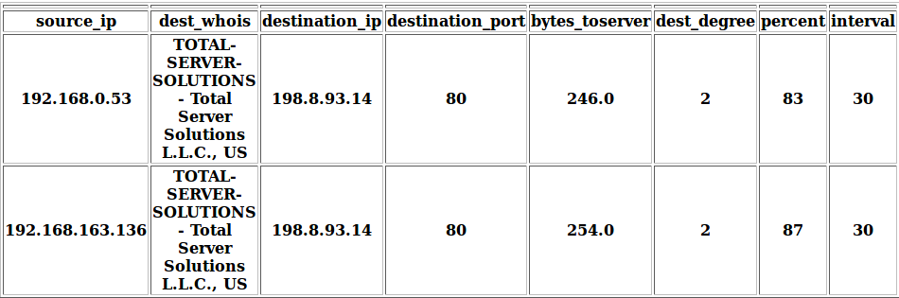

Flare
Austin Taylor wrote a beacon discovery script called Flare
Uses Elasticsearch to crawl historical connections
Identifies connections with consistent beaconing
Supports analysis of custom time periods
Additional capabilities being baked in

Slide 23
ELK Hunter
Designed for analysis, research, and proof of concept
ELK Hunter is a test bed for configs and concepts
Contains Security Onion, ELK, and analysis scripts
Designed to plug into network or deploy to hypervisor
Verifies legitimacy of techniques and configurations
Discover new techniques or abnormal behaviors
Performs mass pcap analysis such as Contagio dumps
https://github.com/SMAPPER/presentations

Slide 24
What Happened?
Organization went from top magic quadrant SIEM to open source with commodity hardware
Business requirements were met
Tactical detection was added
Better understanding of system delivered
Diagnosis
Issue was people and processes not commercial solution
Trained staff are key to implementing and using SIEM

